Slide 1
MD. Feroz Ahmed ID.163133012 Department of EEE Batch: 13th

Slide 2
Welcome my presentation
Topic : Energy and Prospects of Renewable Energy in Bangladesh

Slide 3
Energy and Prospects of Renewable Energy in Bangladesh
Introduction:
Energy is the building block of modern civilization and prerequisite for sustainable development. Global primary energy consumption is increasing with the pace of population growth and rapid urbanization. The primary energy sources include fossil fuels oil, natural gas and coal. Until 2020, it is estimated that fossil fuels will dominate 90% of the total primary energy supply. Oil and other petroleum products are exhaustively used in transportation and other industrial operations. From 1991 to 2011,oil consumption increased by 28.56%.
Coal and natural gas are also at the top of global consumption. It is projected that from year 2011 to 2030, global primary energy consumption will increase by 36% with an annual growth of 1.6%, in which fossil fuel will dominate 88% of the total energy supply.

Slide 4
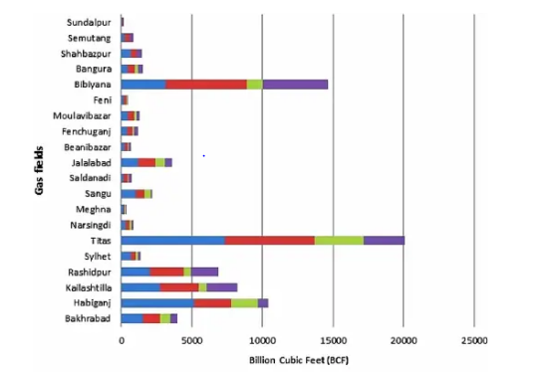
Energy mix in Bangladesh

Slide 5
Renewable energy in Bangladesh
1. Solar power
2. Wind power
3. Tidal power
4. Wave energy
5. Waste to electric energy
6. Biogas
7. Geothermal energy
8. The benefits of renewable energy in Bangladesh

Slide 6
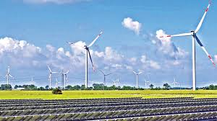
Renewable energy in Bangladesh

Slide 7
Solar power
The long term average sunshine data indicates that the period of bright sunshine hours in the coastal regions of Bangladesh varies from 3 to 11 hours daily. The insolation in Bangladesh varies from 3.8 kWh/m²/day to 6.4 kWh/m²/day at an average of 5 kWh/m²/day. These indicate that there are good prospects for solar thermal and photovoltaic application in the country.
With an estimated 40% of the population in Bangladesh having no access to electricity, the government introduced a scheme known as solar home systems (SHS) to provide electricity to households with no grid access. The program reached 3 million households as of late 2014 and, with more than 50,000 systems being added per month since 2009, the World Bank has called it "the fastest growing solar home system program in the world."

Slide 8
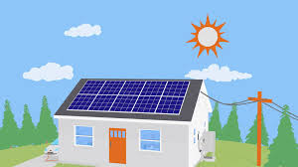
Solar power
Solar electric panel for Home

Slide 9
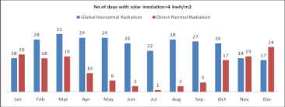
Prospects of Solar Energy in Bangladesh

Slide 10
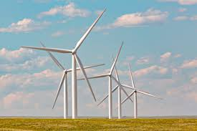
Wind power

Slide 11
Wind power
Wind power or wind energy is the use of wind to provide the mechanical power through wind turbines to turn electric generators and traditionally to do other work, like milling or pumping. Wind power is a sustainable and renewable energy, and has a much smaller impact on the environment compared to burning fossil fuels.
Wind farms consist of many individual wind turbines, which are connected to the electric power transmission network. Onshore wind is an inexpensive source of electric power, competitive with or in many places cheaper than coal or gas plants Onshore wind farms also have an impact on the landscape.

Slide 12
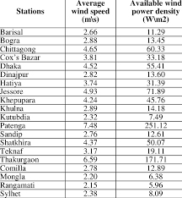
Average wind speed

Slide 13
Tidal Power
Tidal energy is one of the oldest forms of energy generation. It is a renewable form of energy that converts the natural rise and fall of the tides into electricity. Tides are caused by the combined effects of gravitational forces exerted by the Moon, the Sun, and the rotation of the Earth.
Tidal energy presents an evolving technology with tremendous potential. However, it can only be installed along coastlines. Coastlines often experience two high tides and two low tides on a daily basis. The difference in water levels must be at least 5 meters high to produce electricity.

Slide 14
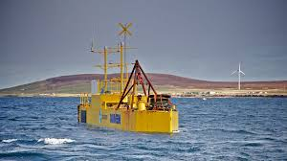
Hydrogen Generated by Tidal Power

Slide 15
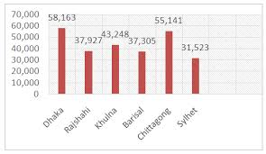
Tidal Power of Graph

Slide 16
Wave energy
Wave energy (or wave power) is the transport and capture of energy by ocean surface waves. The energy captured is then used for all different kinds of useful work, including electricity generation, water desalination, and pumping of water.

Slide 17
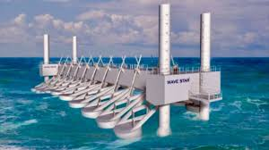
Power Plant Generates Energy From Waves

Slide 18
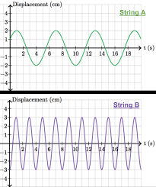
Wave Energy of Graph

Slide 19
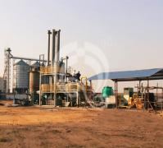
Waste to electric energy
Waste biomass Gasification Power plant

Slide 20
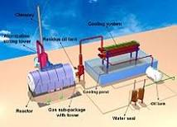
Waste to electric energy
Waste-to-energy (WtE) or energy-from-waste (EfW) is the process of generating energy in the form of electricity and/or heat from the primary treatment of waste, or the processing of waste into a fuel source. WtE is a form of energy recovery.

Slide 21
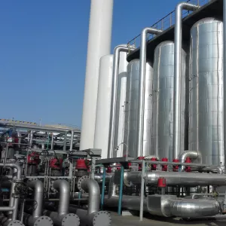
Bio gas
Bio gas purification plant biogas purification system

Slide 22
Biogas use of bangladesh
Animal manures being accessible in the rural areas are greatly used in producing biogas to be used for cooking and electricity. In Bangladesh around 59.6% of the total population is covered by electricity and 6% is covered under natural gas network. About 62.59% of total electricity develops from natural gas.

Slide 23
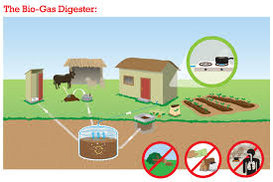
Biogas changing lifestyle of villagers

Slide 24
Geothermal energy
Geothermal energy is heat derived within the sub-surface of the earth. Water and/or steam carry the geothermal energy to the Earth's surface. Depending on its characteristics, geothermal energy can be used for heating and cooling purposes or be harnessed to generate clean electricity.

Slide 25
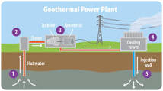
Geothermal power plant

Slide 26
The benefits of renewable energy in Bangladesh
reduce greenhouse gas emissions by up to 20%
generate domestic employment of up to 55,000 full-time equivalent jobs.
Potential to produce additional electricity of 30 GW from the utilisation of solar PV and 53 gigawatt (GW) of electricity potential from all solar sources.

Slide 27
Thank You

